Slide 1
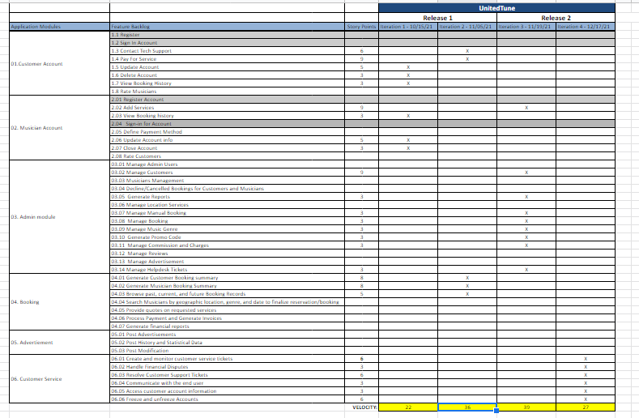
Iteration Backlog (Road Map) Presented By John Brilhart

Slide 2
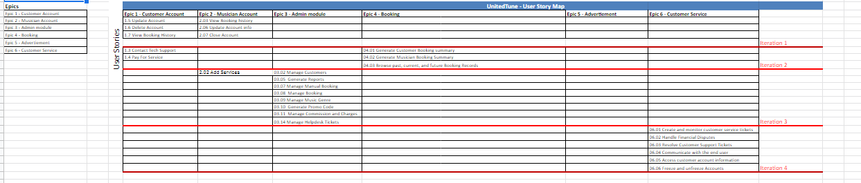
User Story Map Presented By Jay Patel

Slide 3
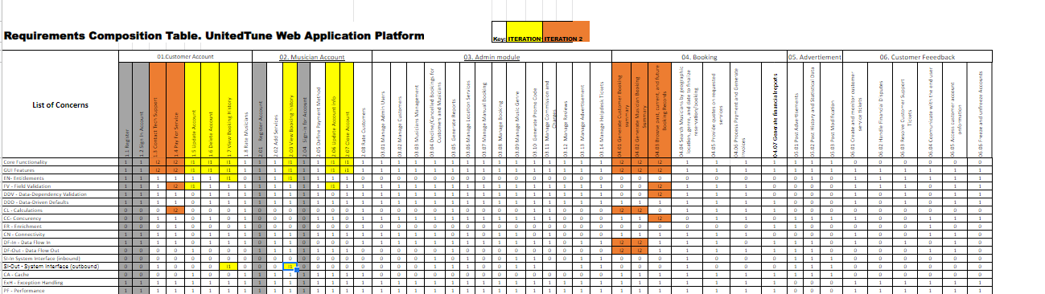
Updated RCT Presented By Yashwanth Varre

Slide 4
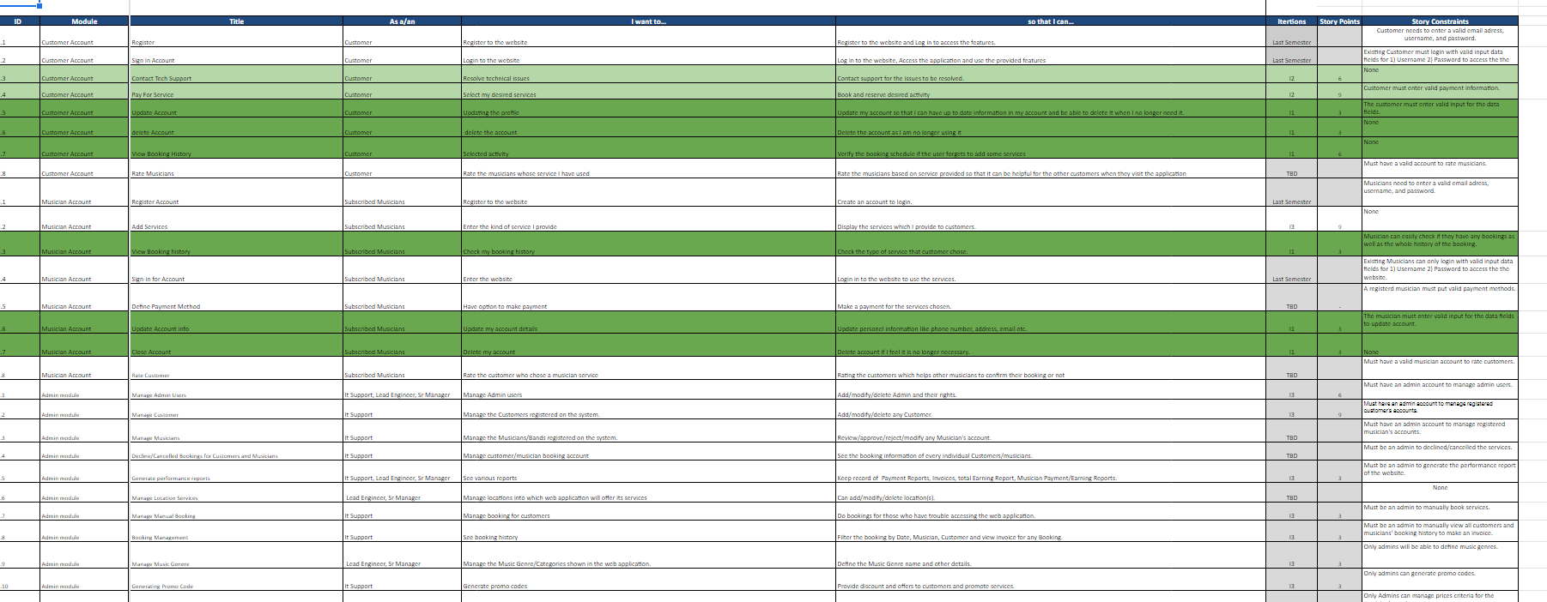
User Stories Presented by Jay Patel

Slide 5
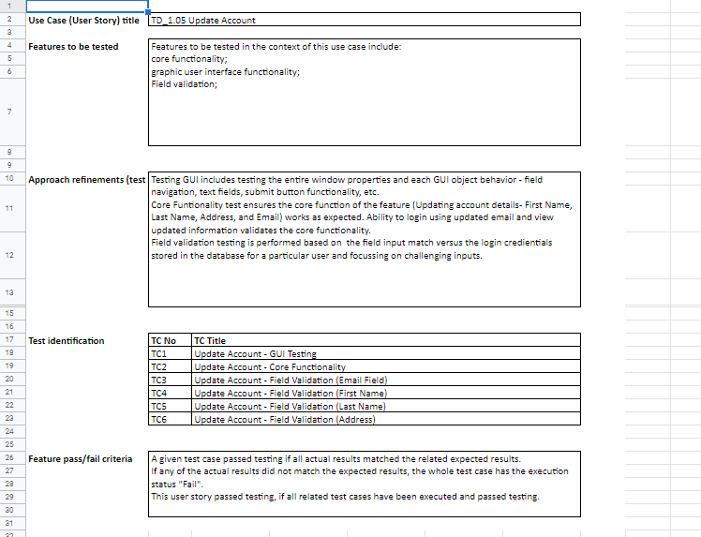
Acceptance Tests Presented By Suraj Suwal

Slide 6
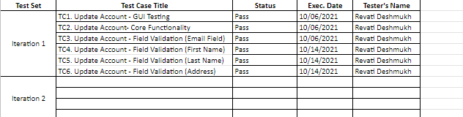
Test Execution Log Presented By Soyeon Ju

Slide 7
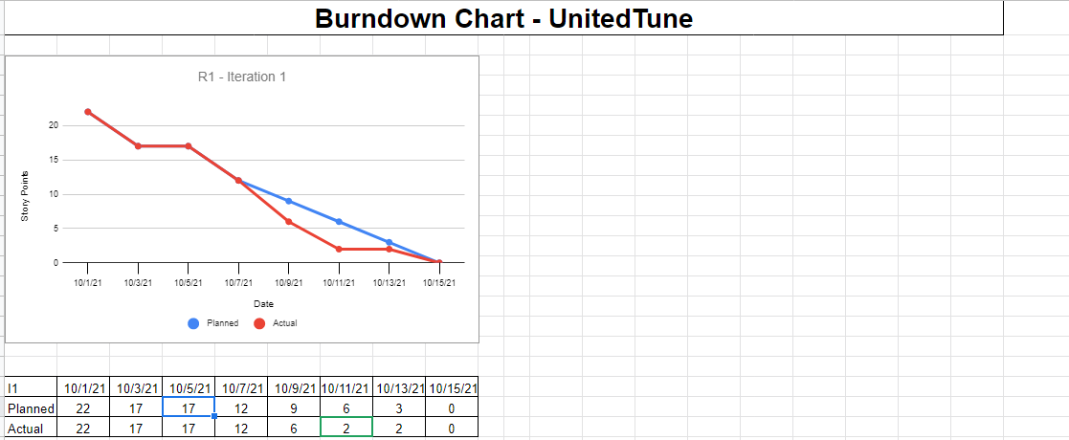
Burn-Down Chart Present By Ge Ou

Slide 8
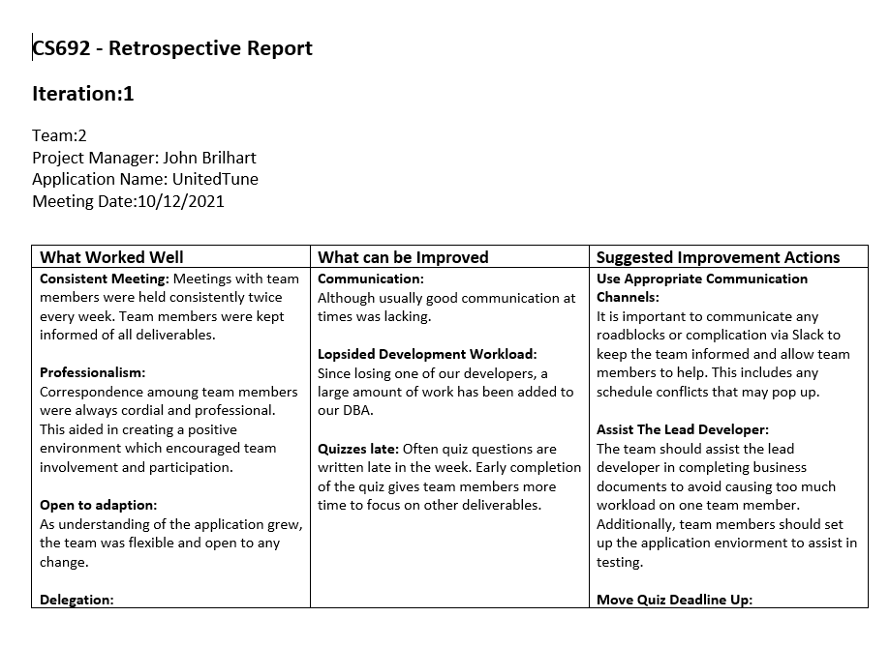
Retrospective Report Presented By John Brilhart

Slide 9
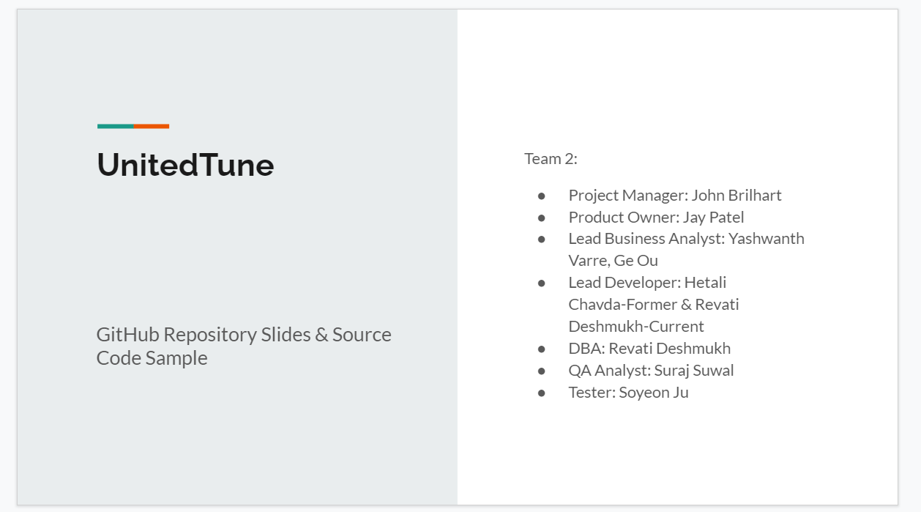
GitHub Repository Demo Presented by Revati Deshmukh

Slide 10
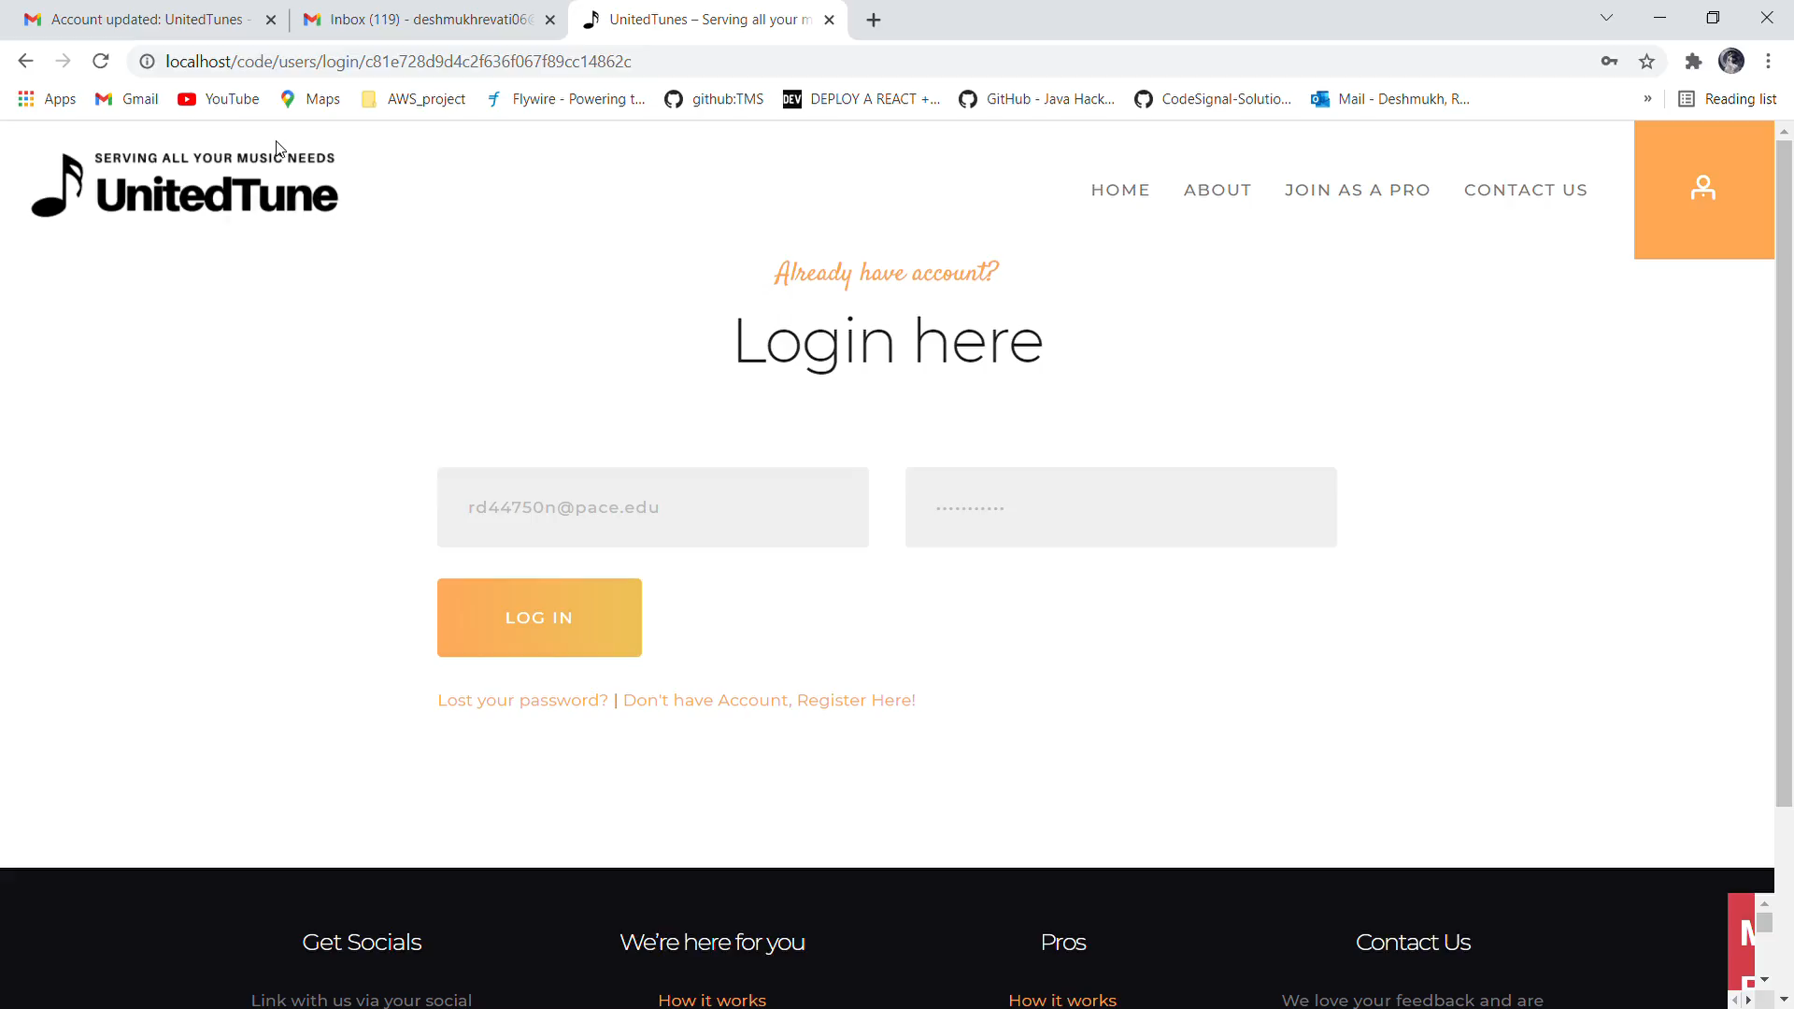
Application Demo Presented by Revati Deshmukh

